Slide 1
DATA Flow Digram
LogicQ

Slide 2
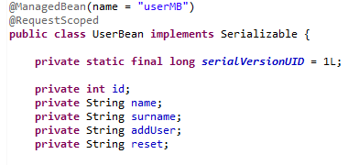

BootStrap+JSF
Index.xhtml
Bean bind by annotation
Component bind to bean

Slide 3
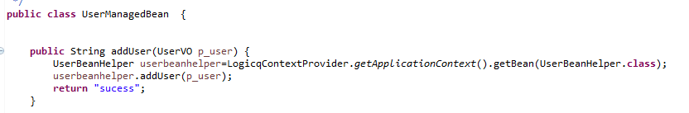
This use only for page + component binding
No business logic here
It use VO object for holding values related to UI
UserVO l_user=LogicqContextProvider.getApplicationContext().getBean(UserVO.class);
Use for UI business logic
1. Add() business logic will handle by UserManagedBean.java

Slide 4
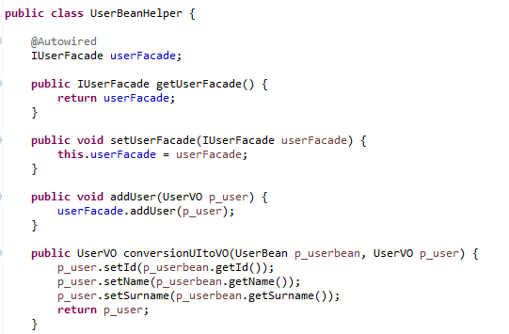
UserManagedBean.java
UserBeanHelper.java
Call to Façade layer of Host and façade will be interface base implimentation
2. Conversion of UIbean to VO Object and vise-versa
3. It will send VO /Httprequest and HttpResponse to Host

Slide 5

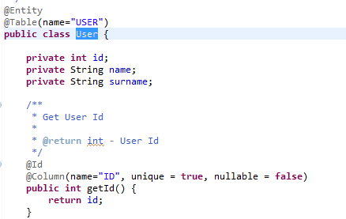
FACADE
SERVICE
Interface base
Interface base
VO POJO/ENTITY
DAO
Transaction
Plan to handle Exception Here only
Hibernate
with annotation

Slide 6
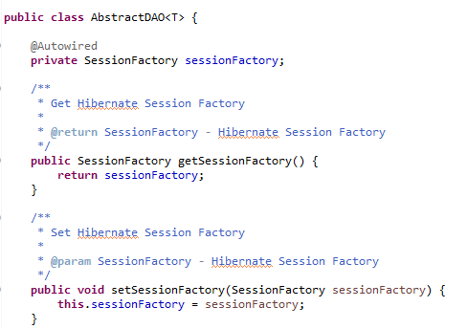
DAO
Please check details with source code related to user

